Slide 1
Advanced Multi-Utility Calculator in Python
By: Aryan Kashyap
Nexthikes IT Solutions

Slide 2
ABOUT THE PROJECT
Python-based application with Calculator, Converter, and Equation Solver
Built using Tkinter, Math, Regex, and SymPy

Slide 3
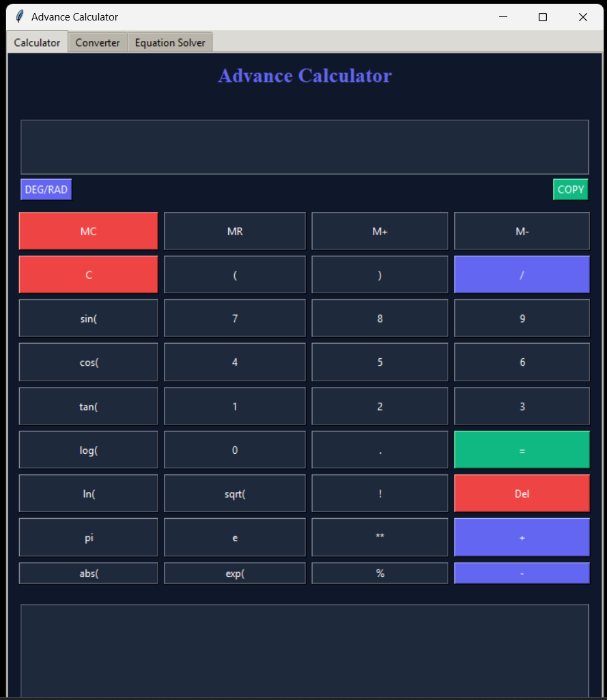
Modern GUI & User Experience
Multi-tab interface: Calculator, Converter, Equation Solver
Dark-themed professional design
Calculation history and copy-to-clipboard support

Slide 4
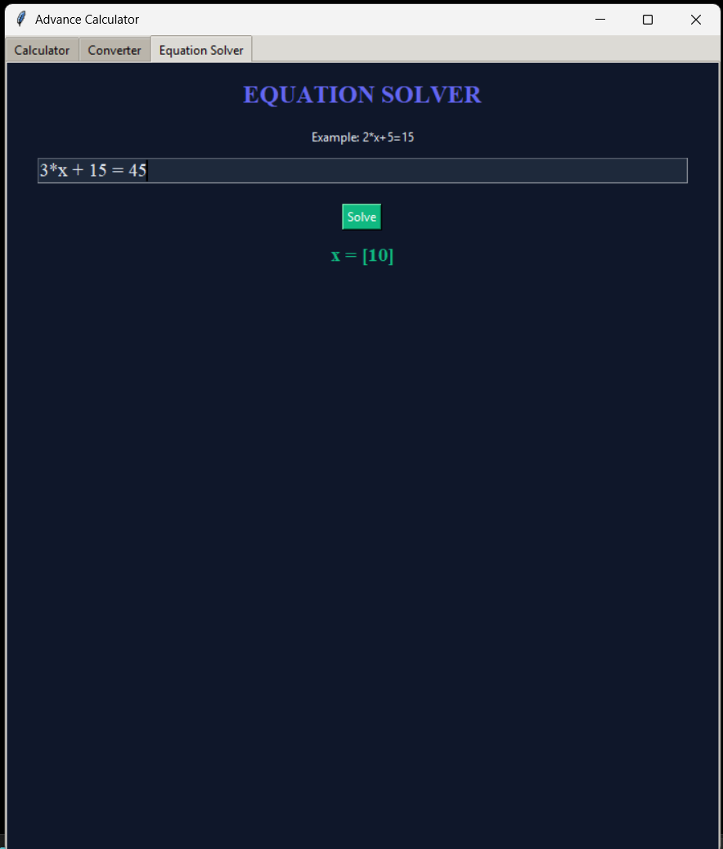
Converter & Equation Solver
Trignometric functions, Factorial functions available
Unit conversions: Length, Weight, Temperature, Volume
SymPy-powered equation solving
Example: 2*x + 5 = 15 → x = 5

Slide 5
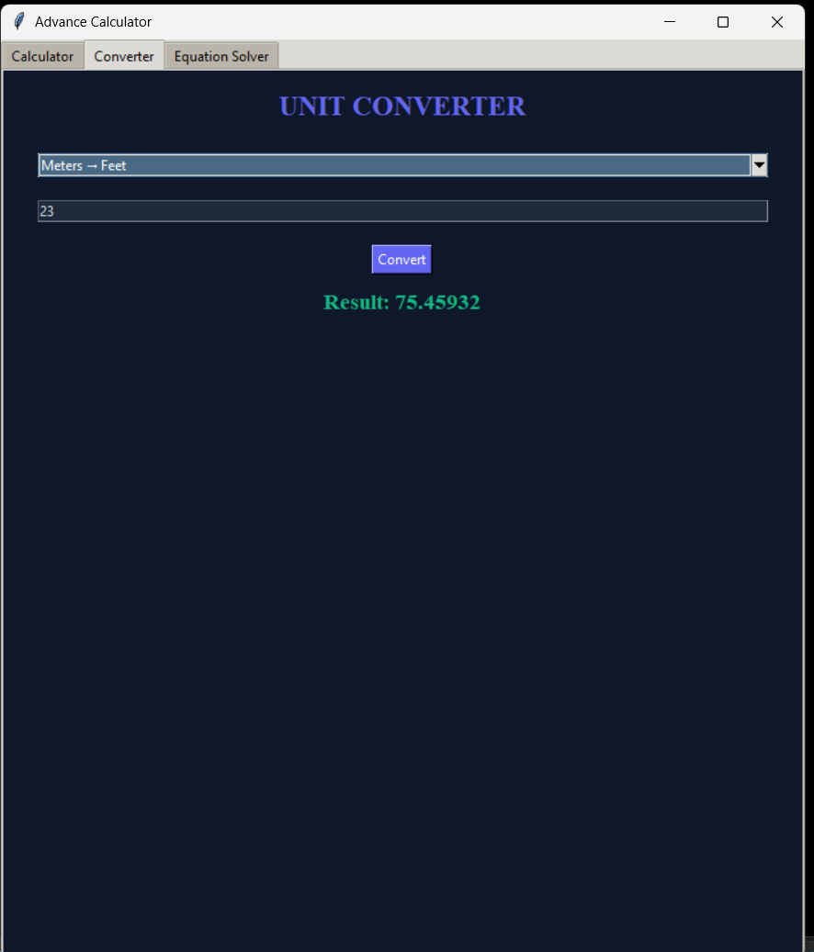

Slide 6
Conclusion
More than a standard calculator
Combines scientific calculations, conversions, and algebra solving

Slide 7
THANK YOU

